Slide 1
Architettura di una memoria RAM
corso di Consapevolezza Digitale
Andrea Gerosa
gerosa@dei.unipd.it – 049.827.7728

Slide 2
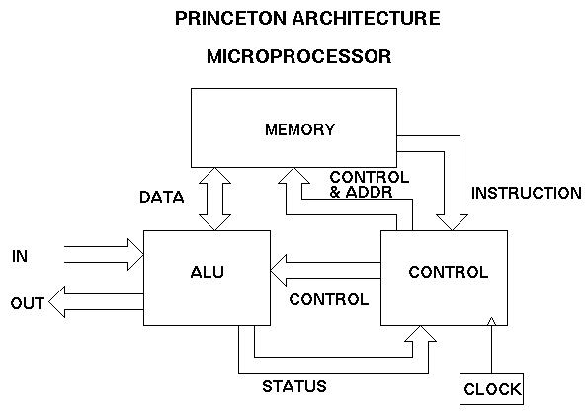
Un semplice microprocessore
Unità di controllo
elabora le istruzioni macchina
abilita gli altri blocchi e funzioni
ALU
elaborazione aritmetica
Memoria
BUS
unidirezionali o bidirezionali

Slide 3
Struttura della memoria RAM
8 colonne (x 8 bit)
La RAM è formata da celle di memoria che memorizzano un byte (tipicamente 8 bit) o word
Le celle sono organizzate in una matrice
cella – M bit
cella – M bit
cella – M bit
cella – M bit
cella – M bit
cella – M bit
cella – M bit
cella – M bit
cella – M bit
cella – M bit
cella – M bit
cella – M bit
cella – M bit
cella – M bit
cella – M bit
cella – M bit
cella – M bit
cella – M bit
cella – M bit
cella – M bit
cella – M bit
cella – M bit
cella – M bit
cella – M bit
cella – M bit
cella – M bit
cella – M bit
cella – M bit
cella – M bit
cella – M bit
cella – M bit
cella – M bit
cella – M bit
cella – M bit
cella – M bit
cella – M bit
cella – M bit
cella – M bit
cella – M bit
cella – M bit
cella – M bit
cella – M bit
cella – M bit
cella – M bit
cella – M bit
cella – M bit
cella – M bit
cella – M bit
cella – M bit
cella – M bit
cella – M bit
cella – M bit
cella – M bit
cella – M bit
cella – M bit
cella – M bit
cella – M bit
cella – M bit
cella – M bit
cella – M bit
cella – M bit
cella – M bit
cella – M bit
cella – M bit
cella – M bit
cella – M bit
cella – M bit
cella – M bit
cella – M bit
cella – M bit
cella – M bit
cella – M bit
cella – M bit
cella – M bit
cella – M bit
cella – M bit
cella – M bit
cella – M bit
cella – M bit
cella – M bit
cella – M bit
cella – M bit
cella – M bit
cella – M bit
cella – M bit
cella – M bit
cella – M bit
cella – M bit
cella – M bit
cella – M bit
cella – M bit
cella – M bit
cella – M bit
cella – M bit
cella – M bit
cella – M bit
cella – M bit
cella – M bit
cella – M bit
cella – M bit
cella – M bit
cella – M bit
cella – M bit
cella – M bit
32 righe
cella – M bit
cella – M bit
cella – M bit
cella – M bit
cella – M bit
cella – M bit
cella – M bit
cella – M bit
cella – M bit
cella – M bit
cella – M bit
cella – M bit
cella – M bit
cella – M bit
cella – M bit
cella – M bit
cella – M bit
cella – M bit
cella – M bit
cella – M bit
cella – M bit
cella – M bit
cella – M bit
cella – M bit
cella – M bit
cella – M bit
cella – M bit
cella – M bit
cella – M bit
cella – M bit
cella – M bit
cella – M bit
cella – M bit
cella – M bit
cella – M bit
cella – M bit
cella – M bit
cella – M bit
cella – M bit
cella – M bit
cella – M bit
cella – M bit
cella – M bit
cella – M bit
cella – M bit
cella – M bit
cella – M bit
cella – M bit
cella – M bit
cella – M bit
cella – M bit
cella – M bit
cella – M bit
cella – M bit
cella – M bit
cella – M bit
cella – M bit
cella – M bit
cella – M bit
cella – M bit
cella – M bit
cella – M bit
cella – M bit
cella – M bit
cella – M bit
cella – M bit
cella – M bit
cella – M bit
cella – M bit
cella – M bit
cella – M bit
cella – M bit
cella – M bit
cella – M bit
cella – M bit
cella – M bit
cella – M bit
cella – M bit
cella – M bit
cella – M bit
cella – M bit
cella – M bit
cella – M bit
cella – M bit
cella – M bit
cella – M bit
cella – M bit
cella – M bit
cella – M bit
cella – M bit
cella – M bit
cella – M bit
cella – M bit
cella – M bit
cella – M bit
cella – M bit
cella – M bit
cella – M bit
cella – M bit
cella – M bit
cella – M bit
cella – M bit
cella – M bit
cella – M bit
cella – M bit
cella – M bit
cella – M bit
cella – M bit
cella – M bit
cella – M bit
cella – M bit
cella – M bit
cella – M bit
cella – M bit
cella – M bit
cella – M bit
cella – M bit
cella – M bit
cella – M bit
cella – M bit
cella – M bit
cella – M bit
cella – M bit
cella – M bit
cella – M bit
cella – M bit
cella – M bit
cella – M bit
cella – M bit
cella – M bit
cella – M bit
cella – M bit
cella – M bit
cella – M bit
cella – M bit
cella – M bit
cella – M bit
cella – M bit
cella – M bit
cella – M bit
cella – M bit
cella – M bit
cella – M bit
cella – M bit
cella – M bit
cella – M bit
cella – M bit
cella – M bit
cella – M bit
cella – M bit
cella – M bit
cella – M bit
8x32 = 256byte = 2kbit

Slide 4
Indirizzamento della memoria
Passo 1
individuo quale riga voglio usare
ogni riga ha un proprio segnale di attivazione (WL)
WL0
cella – M bit
cella – M bit
cella – M bit
cella – M bit
cella – M bit
cella – M bit
cella – M bit
cella – M bit
WL1
cella – M bit
cella – M bit
cella – M bit
cella – M bit
cella – M bit
cella – M bit
cella – M bit
cella – M bit
WL2
cella – M bit
cella – M bit
cella – M bit
cella – M bit
cella – M bit
cella – M bit
cella – M bit
cella – M bit
WL3
cella – M bit
cella – M bit
cella – M bit
cella – M bit
cella – M bit
cella – M bit
cella – M bit
cella – M bit
WL4
cella – M bit
cella – M bit
cella – M bit
cella – M bit
cella – M bit
cella – M bit
cella – M bit
cella – M bit
WL5
cella – M bit
cella – M bit
cella – M bit
cella – M bit
cella – M bit
cella – M bit
cella – M bit
cella – M bit
WL6
cella – M bit
cella – M bit
cella – M bit
cella – M bit
cella – M bit
cella – M bit
cella – M bit
cella – M bit
WL7
cella – M bit
cella – M bit
cella – M bit
cella – M bit
cella – M bit
cella – M bit
cella – M bit
cella – M bit
WL8
cella – M bit
cella – M bit
cella – M bit
cella – M bit
cella – M bit
cella – M bit
cella – M bit
cella – M bit
WL9
1
cella – M bit
cella – M bit
cella – M bit
cella – M bit
cella – M bit
cella – M bit
cella – M bit
cella – M bit
WL10
cella – M bit
cella – M bit
cella – M bit
cella – M bit
cella – M bit
cella – M bit
cella – M bit
cella – M bit
WL11
cella – M bit
cella – M bit
cella – M bit
cella – M bit
cella – M bit
cella – M bit
cella – M bit
cella – M bit
WL12
cella – M bit
cella – M bit
cella – M bit
cella – M bit
cella – M bit
cella – M bit
cella – M bit
cella – M bit
WL13
cella – M bit
cella – M bit
cella – M bit
cella – M bit
cella – M bit
cella – M bit
cella – M bit
cella – M bit
WL14
cella – M bit
cella – M bit
cella – M bit
cella – M bit
cella – M bit
cella – M bit
cella – M bit
cella – M bit
WL15
cella – M bit
cella – M bit
cella – M bit
cella – M bit
cella – M bit
cella – M bit
cella – M bit
cella – M bit
WL16
cella – M bit
cella – M bit
cella – M bit
cella – M bit
cella – M bit
cella – M bit
cella – M bit
cella – M bit
WL17
cella – M bit
cella – M bit
cella – M bit
cella – M bit
cella – M bit
cella – M bit
cella – M bit
cella – M bit
WL18
cella – M bit
cella – M bit
cella – M bit
cella – M bit
cella – M bit
cella – M bit
cella – M bit
cella – M bit
WL19
cella – M bit
cella – M bit
cella – M bit
cella – M bit
cella – M bit
cella – M bit
cella – M bit
cella – M bit
WL20
cella – M bit
cella – M bit
cella – M bit
cella – M bit
cella – M bit
cella – M bit
cella – M bit
cella – M bit
WL21
cella – M bit
cella – M bit
cella – M bit
cella – M bit
cella – M bit
cella – M bit
cella – M bit
cella – M bit
WL22
cella – M bit
cella – M bit
cella – M bit
cella – M bit
cella – M bit
cella – M bit
cella – M bit
cella – M bit
WL23
cella – M bit
cella – M bit
cella – M bit
cella – M bit
cella – M bit
cella – M bit
cella – M bit
cella – M bit
WL24
cella – M bit
cella – M bit
cella – M bit
cella – M bit
cella – M bit
cella – M bit
cella – M bit
cella – M bit
WL25
cella – M bit
cella – M bit
cella – M bit
cella – M bit
cella – M bit
cella – M bit
cella – M bit
cella – M bit
WL26
cella – M bit
cella – M bit
cella – M bit
cella – M bit
cella – M bit
cella – M bit
cella – M bit
cella – M bit
WL27
cella – M bit
cella – M bit
cella – M bit
cella – M bit
cella – M bit
cella – M bit
cella – M bit
cella – M bit
WL28
cella – M bit
cella – M bit
cella – M bit
cella – M bit
cella – M bit
cella – M bit
cella – M bit
cella – M bit
WL29
cella – M bit
cella – M bit
cella – M bit
cella – M bit
cella – M bit
cella – M bit
cella – M bit
cella – M bit
WL30
cella – M bit
cella – M bit
cella – M bit
cella – M bit
cella – M bit
cella – M bit
cella – M bit
cella – M bit
WL31
cella – M bit
cella – M bit
cella – M bit
cella – M bit
cella – M bit
cella – M bit
cella – M bit
cella – M bit

Slide 5
Indirizzamento della memoria
Passo 2
individuo quale colonna va mandata in uscita
ogni colonna ha un proprio segnale di attivazione (BL)
WL0
cella – M bit
cella – M bit
cella – M bit
cella – M bit
cella – M bit
cella – M bit
cella – M bit
cella – M bit
WL1
cella – M bit
cella – M bit
cella – M bit
cella – M bit
cella – M bit
cella – M bit
cella – M bit
cella – M bit
WL2
cella – M bit
cella – M bit
cella – M bit
cella – M bit
cella – M bit
cella – M bit
cella – M bit
cella – M bit
WL3
cella – M bit
cella – M bit
cella – M bit
cella – M bit
cella – M bit
cella – M bit
cella – M bit
cella – M bit
WL4
cella – M bit
cella – M bit
cella – M bit
cella – M bit
cella – M bit
cella – M bit
cella – M bit
cella – M bit
WL5
cella – M bit
cella – M bit
cella – M bit
cella – M bit
cella – M bit
cella – M bit
cella – M bit
cella – M bit
WL6
cella – M bit
cella – M bit
cella – M bit
cella – M bit
cella – M bit
cella – M bit
cella – M bit
cella – M bit
WL7
cella – M bit
cella – M bit
cella – M bit
cella – M bit
cella – M bit
cella – M bit
cella – M bit
cella – M bit
WL8
cella – M bit
cella – M bit
cella – M bit
cella – M bit
cella – M bit
cella – M bit
cella – M bit
cella – M bit
WL9
1
cella – M bit
cella – M bit
cella – M bit
cella – M bit
cella – M bit
cella – M bit
cella – M bit
cella – M bit
WL10
cella – M bit
cella – M bit
cella – M bit
cella – M bit
cella – M bit
cella – M bit
cella – M bit
cella – M bit
WL11
cella – M bit
cella – M bit
cella – M bit
cella – M bit
cella – M bit
cella – M bit
cella – M bit
cella – M bit
WL12
cella – M bit
cella – M bit
cella – M bit
cella – M bit
cella – M bit
cella – M bit
cella – M bit
cella – M bit
WL13
cella – M bit
cella – M bit
cella – M bit
cella – M bit
cella – M bit
cella – M bit
cella – M bit
cella – M bit
WL14
cella – M bit
cella – M bit
cella – M bit
cella – M bit
cella – M bit
cella – M bit
cella – M bit
cella – M bit
WL15
cella – M bit
cella – M bit
cella – M bit
cella – M bit
cella – M bit
cella – M bit
cella – M bit
cella – M bit
WL16
cella – M bit
cella – M bit
cella – M bit
cella – M bit
cella – M bit
cella – M bit
cella – M bit
cella – M bit
WL17
cella – M bit
cella – M bit
cella – M bit
cella – M bit
cella – M bit
cella – M bit
cella – M bit
cella – M bit
WL18
cella – M bit
cella – M bit
cella – M bit
cella – M bit
cella – M bit
cella – M bit
cella – M bit
cella – M bit
WL19
cella – M bit
cella – M bit
cella – M bit
cella – M bit
cella – M bit
cella – M bit
cella – M bit
cella – M bit
WL20
cella – M bit
cella – M bit
cella – M bit
cella – M bit
cella – M bit
cella – M bit
cella – M bit
cella – M bit
WL21
cella – M bit
cella – M bit
cella – M bit
cella – M bit
cella – M bit
cella – M bit
cella – M bit
cella – M bit
WL22
cella – M bit
cella – M bit
cella – M bit
cella – M bit
cella – M bit
cella – M bit
cella – M bit
cella – M bit
WL23
cella – M bit
cella – M bit
cella – M bit
cella – M bit
cella – M bit
cella – M bit
cella – M bit
cella – M bit
WL24
cella – M bit
cella – M bit
cella – M bit
cella – M bit
cella – M bit
cella – M bit
cella – M bit
cella – M bit
WL25
cella – M bit
cella – M bit
cella – M bit
cella – M bit
cella – M bit
cella – M bit
cella – M bit
cella – M bit
WL26
cella – M bit
cella – M bit
cella – M bit
cella – M bit
cella – M bit
cella – M bit
cella – M bit
cella – M bit
WL27
cella – M bit
cella – M bit
cella – M bit
cella – M bit
cella – M bit
cella – M bit
cella – M bit
cella – M bit
WL28
cella – M bit
cella – M bit
cella – M bit
cella – M bit
cella – M bit
cella – M bit
cella – M bit
cella – M bit
WL29
cella – M bit
cella – M bit
cella – M bit
cella – M bit
cella – M bit
cella – M bit
cella – M bit
cella – M bit
WL30
cella – M bit
cella – M bit
cella – M bit
cella – M bit
cella – M bit
cella – M bit
cella – M bit
cella – M bit
WL31
cella – M bit
cella – M bit
cella – M bit
cella – M bit
cella – M bit
cella – M bit
cella – M bit
cella – M bit
BL0
BL1
BL2
BL3
BL4
BL5
BL6
BL7
1
DATA BUS

Slide 6
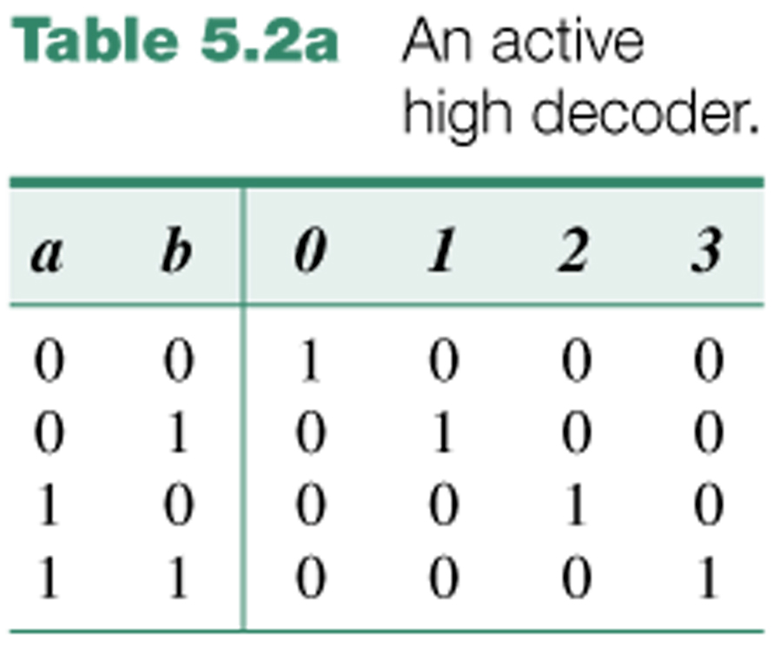
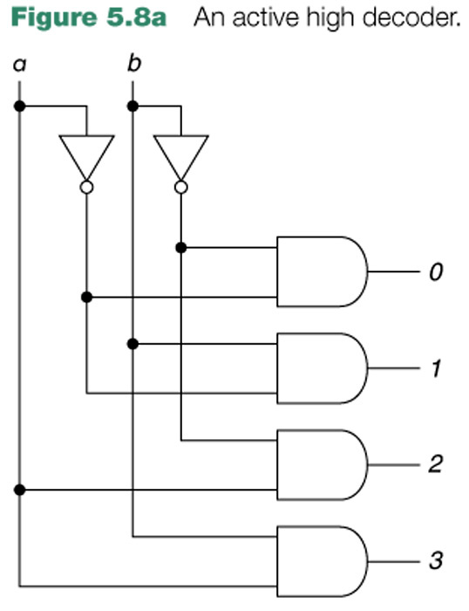
Decoder di riga
Uso un numero binario a N bit per identificare quale WL deve essere attivata
posso distinguere tra 2^{N} WL
Decoder binario
32 WL  5 ingressi
16k WL  14 ingressi!

Slide 7



Decoder multistadio
$$WL0=\overline{A_{0}}∙\overline{A_{1}}∙\overline{A_{2}}∙\overline{A_{3}}∙\overline{A_{4}}$$
$$WL0=\left(\overline{A_{0}}∙\overline{A_{1}}\right)∙\left(\overline{A_{2}}∙\overline{A_{3}}\right)∙\overline{A_{4}}$$
$$WL0=\overline{\overline{\left(\overline{A_{0}}∙\overline{A_{1}}\right)}+\overline{\left(\overline{A_{2}}∙\overline{A_{3}}\right)}+\overline{\overline{A_{4}}}}$$

Slide 8
Decoder di colonna
BL
0
BL
1
BL
2
BL
3
Uso un numero binario a K bit per identificare quale BL deve essere collegata in uscita
posso distinguere tra 2^{K} BL
Decoder + Multiplexer
8 BL  192 interruttori
2e3 BL  61.400 interruttori
S
0
A
0
S
1
S
2
A
1
S
3
D

Slide 9
Struttura gerarchica
Block P-1
Es. 1Gbit DDR
8 moduli (128MB)
128MB=2¹⁴ WL x 2¹¹ BL x 2² Blocchi

